Slide 1
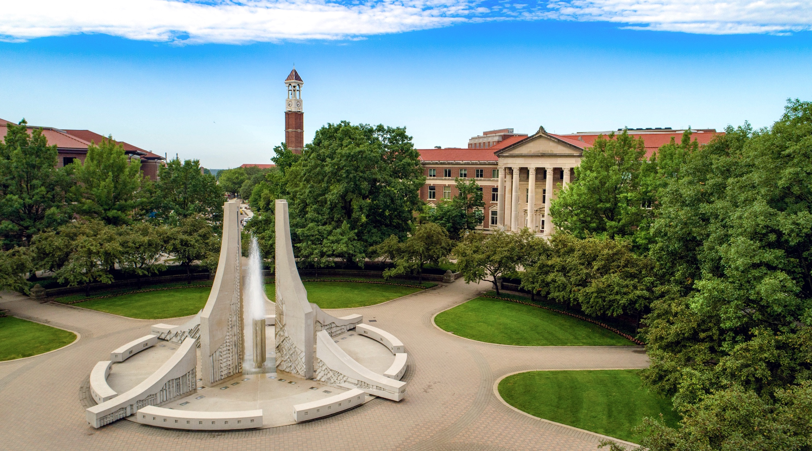
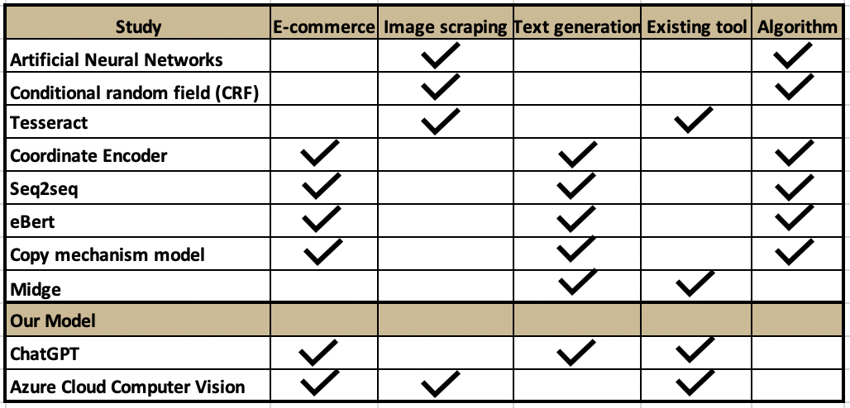
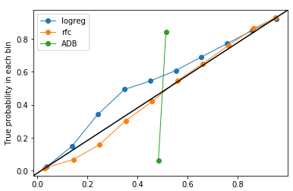
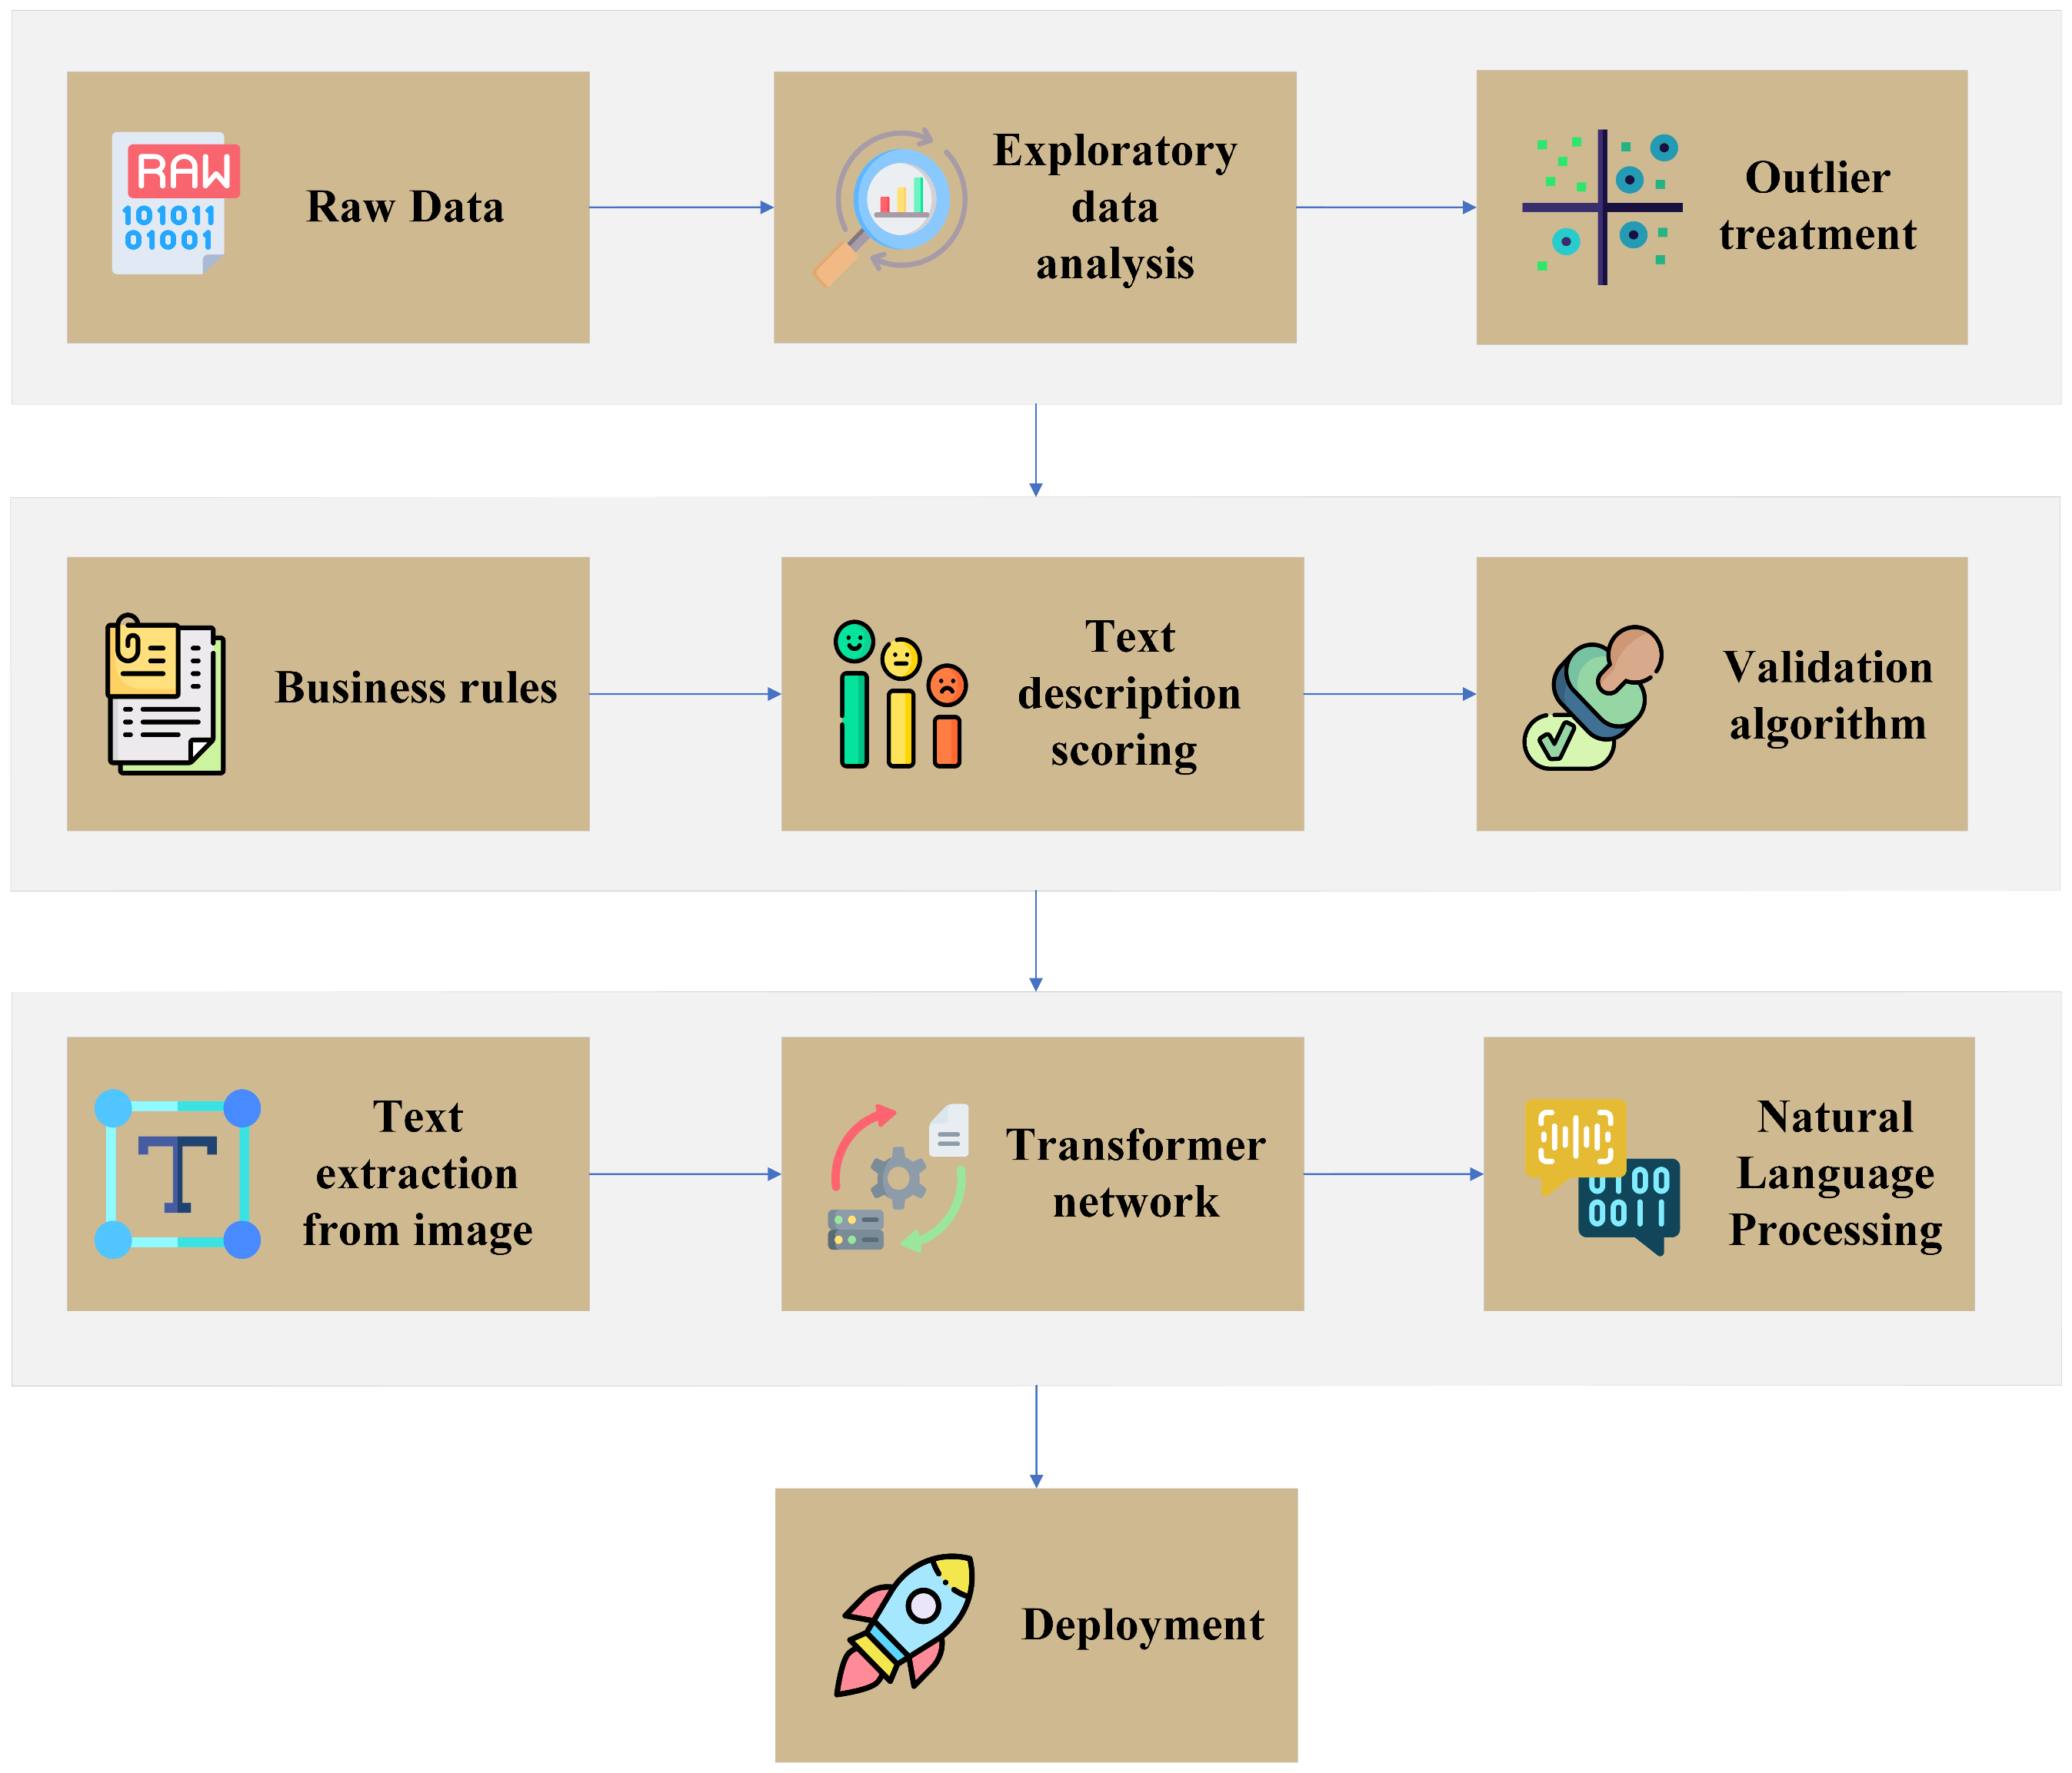
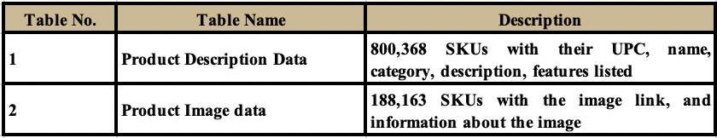

LITERATURE REVIEW
STATISTICAL RESULTS
EXPECTED IMPACT
There are many types of OCR prevalent in the current industry, while the combination of Azure Cloud Computer Vision and ChatGPT has not been worked on yet. Azure Cloud Computer vision helps to accurately extract text from image among all the options available and is our choice for building the model.
Discuss the performance of your models and refer to the figure. Don’t use a table, create a nice-looking plot(s) in Tableau, Excel, or R.
Discuss the “expected or potential” impact the performance of your model could have. Since you did not work directly with a company, you are framing this as a potential scenario in a how a company could benefit from your insights.
Create a nice-looking plot(s) in Tableau, Excel, or R. Ideally this figure(s) would be one of a few things:
Translate your statistical results to potential business results/impact
If an interpretable model, discuss the impacts/effects on the outcome with corresponding confidence intervals
If prediction accuracy was a focus, say an 80% accuracy (from your best model) versus a 75% accuracy, how does this 5% improvement impact the business business, customer, or other stakeholder?
Unstructured Data Analysis to Improve Digital Eligibility of E-Commerce Listings
Suneet Abraham, Akshay Deshmukh, Anish Jasti, Sharan Shirodkar, Nikhitha Siddi
Matthew A. Lanham
Purdue University, Krannert School of Management
abraha46@purdue.edu; deshmu25@purdue.edu; jastia@purdue.edu; sshirodk@purdue.edu; nsiddi@purdue.edu; lanhamm@purdue.edu
2.3 M
5.9 M
50.6 M
Table 1. Literature Summary
11.5 M
2.1 M
50.6
21 M
ABSTRACT
Fig 3. Model Results
Fig 4. Probability Calibration Plot
7.9 M
A grocery chain needs to improve the quality of descriptions on their website well as create descriptions where not present. We score the existing product descriptions and create a model to generate product description based on the product images. This automation will reduce the manual efforts and set a quality standard for the descriptions. We used OCR to extract text, and ChatGpt to generate descriptions.
METHODOLOGY
Discuss the performance of your models and refer to the figure. Don’t use a table, create a nice-looking plot(s) in Tableau, Excel, or R.
Produce
Deli
Meat
Grocery
Seafood
Others
Total
Fig 5. Total Net Savings ($) based on predicted OOS instances
INTRODUCTION
CONCLUSIONS
Problem: We are working with a National supercenter chain that requires vendors to provide product information and at least one image to make their products digitally eligible for the website. However, failure on the vendors' end to meet these requirements is resulting in many products not being listed on the client's website, leading to inconsistent service for customers. Currently, only 33% of the products in the grocery chain's portfolio meet the necessary requirements to be featured on the website.
Solution: To address the low digital eligibility issue, we are generating missing product descriptions, assessing current descriptions for improvement and establishing SOPs. Our primary performance indicator will be the increase in digital eligible listings. We anticipate that improving digital eligibility will lead to higher customer satisfaction and increased sales.
Provide answers to your research questions here, possibly using bullet points to be clear to your reader.
Anything else you feel is an important take-away that led to your result (e.g. how you created features, the models or software you used, etc.). If nothing important comes to mind, how do you think your project and insights could be improved based on your studies limitations (e.g. available data, domain knowledge, technology barriers, etc.)
Fig 3. Model Results
Fig 4. Probability Calibration Plot
DATA
ACKNOWLEDGEMENTS
In this study, we used two data tables provided by the client - product description and product image data.
We would like to thank Professor Matthew Lanham and our industry partner for this opportunity, their guidance, and support on this project.
RESEARCH OBJECTIVES
Fig 3. Model Results
Fig 4. Probability Calibration Plot
Can we generate a good quality description for a product by using the text from the image label?
Can we create a scoring algorithm to separate out the good descriptions from the bad descriptions?

